Slide 1
Angular - Services
Peter Eijgermans peter.eijgermans@ordina.nl

Slide 2
Services
Target – make data functionality reusable for different components:
Data retrieval, Data caching, Data Storage

Slide 3
Singleton?
Services are singletons
They are a singleton for the Module and all child components.
Module/Site-wide usage?
Instantiate the service in app.module.ts
4

Slide 4
Data flow
View
{{…}}
Class / Component
Service
Save your data via Http
API → Database

Slide 5
Data flow
View
{{…}}
Class / Component
Service
View
{{…}}
Class / Component

Slide 6
Why use a Service?
Make data functionality reusable for different components
Data functionality available for all components
Data will be available when you switch from component/view
(components are volatile to “share” data)
Contains logic that is not directly related to the view!!!

Slide 7
Basic Rule Service
Put all your (business)logic in the service !
The Component should be lean and mean !

Slide 8
Services in Angular
Data services in Angular:
import {Injectable} from '@angular/core';
@Injectable()
export class CityService{
//....
}
Notes:
The @Injectable() decorator marks it as a service that can be injected

Slide 9
Steps to make a Service
Step 1 – create a service
Step 2 – consume/inject service in component
Step 3 – inject service in Module (app.module.ts)

Slide 10
Step 1 – service (static data)
import { Injectable } from '@angular/core'; import { City } from './city.model'
@Injectable()
export class CityService { cities:City[] = [
new City(1, 'Groningen', 'Groningen'),
…
];
// retourneer alle cities
getCities(): City[] {
return this.cities
}
// retourneer city op basis van ID
getCity(id:number) : City {
return this.cities.find(c => c.id === id);
}
}

Slide 11
Step 2 – Service consume/inject
…
import {CityService} from "./city.service";
@Component({
selector : 'hello‐world', templateUrl: 'app/app.html',
})
export class AppComponent implements OnInit {
// Properties voor de component/class
currentCity: City; cities: City[]; cityPhoto: string;
Constructor: shorthand voor nieuwe private variable + instantiering!
local variables
constructor(private cityService: CityService) {
}
ngOnInit() {
this.cities = this.cityService.getCities();
}
Detailgegevens voor city bij (click) event
getCity(city: City) {
this.currentCity = this.cityService.getCity(city.id); this.cityPhoto = `img/${this.currentCity.name}.jpg`;
console.log('City opgehaald:', this.currentCity);
}
}

Slide 12
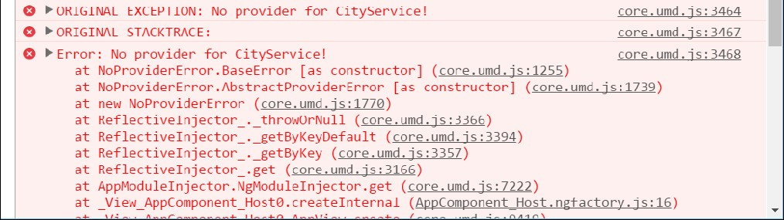
“No provider for CityService”
Solution: inject in app.module.ts

Slide 13
Step 3 – Inject service in Module (app.module.ts)
Use the annotation providers:[ … ]
// Module declaration
@NgModule({
imports : [BrowserModule], declarations: [AppComponent],
bootstrap providers
: [AppComponent],
: [CityService, GoogleService] // DI voor service
})
export class AppModule {
}
Array met Service- dependencies

Slide 14

Checkpoint
See 5a
Exercise….

Slide 15
Async services

Slide 17
Async Services
Work with HttpClient: asynchrone actie
AngularJs: Promises
Angular : Observables
Use in Angular : ReactiveX library RxJS

Slide 18

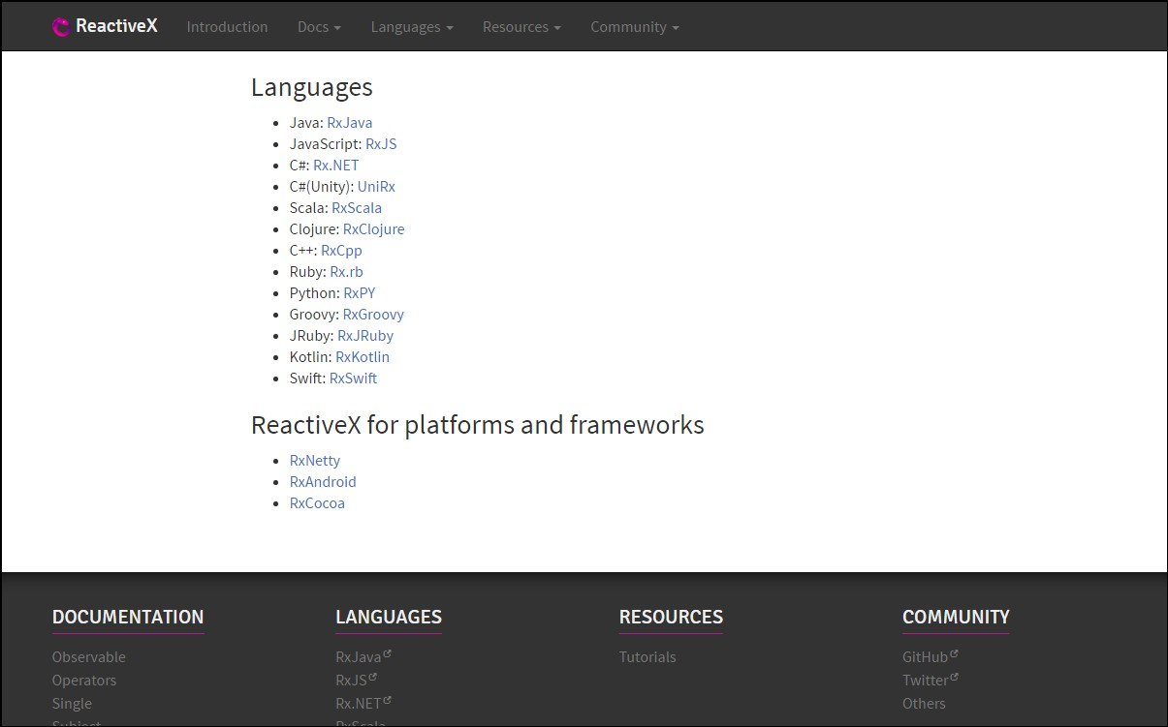
http://reactivex.io/

Slide 19
Observable
Subscribe
Notes:
You are a Observer = Listener and Subscriber on the data
TV is the Observable = Provider of Async data

Slide 20
Observable
Returns a stream of values over time

Slide 21


Slide 22
Observable
Cancelable
Returns a stream of values over time
Lazy
Subscribe to the stream (push mechanism)
Array-methods on stream → map(), filter(), reduce()
Notes:
Lazy: er gebeurt niks met de ontvangen stream, totdat hij aangeroepen wordt
Observable is te vergelijken met een array, die langzamerhand gevuld wordt met data.
Omdat een observable zich gedraagd als een array, zijn allerlei array methods beschikbaar, zoals: map(), filter(), reduce()
Example stream: list of ’share prices’ which changes each minute.

Slide 23
Interactive diagrams of Rx Observables
http://rxmarbles.com/
RXFiddle.net

Slide 24
Observable syntax
let source = Rx.Observable
.Operators() (→ map(), reduce())
let result = source.subscribe(x => console.log(x))
Notes:
Subscribe always on the incoming data-stream !!! (= PUSH BERICHT)
Use ES6 arrow functions

Slide 25
Async services
App, met
View
Webserver, met API &
Database
Internet
Controller
Ajax-call, met Http
Service

Slide 26
Example Http / cities.json
Make a data-file: cities.json
[
{
"id"
"name" "province"
: 1,
: "Groningen",
: "Groningen",
"highlights": "Martinitoren"
},
…
]

Slide 27
Step 1 - Inject HttpClient in Service
import {Observable} from "rxjs";
import {HttpClient} from ‘@angular/common/http';
Maak lokale variabele http
@Injectable()
export class CityService {
constructor(private http: HttpClient) {
}
// retourneer alle cities
getCities(): Observable<City[]> {
return this.http.get<City[] >('app/cities.json')
}
…
Retourneer observable naar de Component
}

Slide 28
Step 2 – Change component
export class AppComponent implements OnInit {
// Properties voor de component/class
currentCity: City; cities: City[]; cityPhoto: string;
constructor(private cityService: CityService) {
}
Data async ophalen en .subscribe() gebruiken
ngOnInit() { this.cityService.getCities()
.subscribe(cityData => { this.cities = cityData
},
err => console.log('FOUT: ', err),
() => console.log('Getting cities complete'))
}
}

Slide 29
Step 3 – Change module
// Angular Modules
…
import {HttpClientModule} from "@angular/common/http";
…
// Module declaration
@NgModule({
HttpModule importeren en toevoegen
imports
: [BrowserModule, HttpClientModule],
declarations: [AppComponent],
bootstrap providers
: [AppComponent],
: [CityService] // DI voor service
})
export class AppModule {
}

Slide 30
More about Observables
Part of RxJs
subscribe() has 3 parameters:
success
▪
error
complete
this.cityService.getCities()
.subscribe(cityData => {
this.cities = cityData;
},
err => console.log(err),
()=> console.log('Getting cities complete...')
)

Slide 31
Checkpoint Async services
Oefening 5b)
Exercise….

Slide 32
How to import RxJs in your application?
import 'rxjs’;
import {Observable} from ‘rxjs’;
import {map, filter, delay, retry} from 'rxjs/operators';
Notes:
Piping. Resultaat van de een functie (retry, delay) dient als invoer voor de volgende functie.

Slide 33
PIPING
r
import rxjs operatoren
import {retry, delay} from 'rxjs/operators’;
export class AppComponent implements OnInit {
// Properties voor de component/class
currentCity: City; cities: City[]; cityPhoto: string;
constructor(private cityService: CityService) {
}
Data async ophalen en retry and delay als ophalen mislukt
ngOnInit() { this.cityService.getCities()
.pipe(retry(10), delay(2000))
.subscribe(cityData => { this.cities = cityData
},
err => console.log('FOUT: ', err),
() => console.log('Getting cities complete'))
}
}
Notes:
Piping. Resultaat van de een functie (retry, delay) dient als invoer voor de volgende functie.

Slide 34
RxJS-operators in the service
import {Injectable}. from '@angular/core’;
import {City} from '../model/city.model';
import. {HttpClient} from ‘@angular/common/http’;
import {Observable}. from ‘rxjs';
import {catchError, tap} from 'rxjs/operators';
Import operators
@Injectable()
export class CityService {
constructor(private http: Http) {
}
// retourneer alle cities
getCities(): Observable<City[]> {
return this.http.get<City[]>('app/cities.json')
.pipe(
tap(_ => this.log('fetched cities')),
catchError(this.log(‘error fetching cities'))
);
}
Transform stream in de service

Slide 35
Checkpoint piping
See 5c
Exercise….

Slide 36
CRUD applicatie
POST
PUT
DELETE
GET
Notes:
https://blog.angularindepth.com/angular-question-rxjs-subscribe-vs-async-pipe-in-component-templates-c956c8c0c794

Slide 37
Adding a City
const headers = new HttpHeaders().set('Content-Type', 'application/json');
const HEADERS = {headers: headers};
addCity(cityName: string): Observable<City> {
const newCity = new City(null, cityName);
return this.http.post<City>( → <City> is return type
API_URL,
JSON.stringify(newCity),
HEADERS
)
}

Slide 38
Update a City
updateCity(city: City): Observable<City> {
return this.http.put<City>(
url + `/${city.id}`,
JSON.stringify(city),
headers)
}

Slide 39
Delete a City
deleteCity(city) {
return this.http.delete(url + `/${city.id}`)
}

Slide 40

CRUD application
Notes:
https://blog.angularindepth.com/angular-question-rxjs-subscribe-vs-async-pipe-in-component-templates-c956c8c0c794

Slide 41
Checkpoint CRUD applicatie
See 5d
Exercise….

Slide 42
Async pipe
.subscribe() versus | async
| Async also unsubscribes !!!
Notes:
https://blog.angularindepth.com/angular-question-rxjs-subscribe-vs-async-pipe-in-component-templates-c956c8c0c794

Slide 43
DEMO 206 services–async-pipe
<li *ngFor="let city of cities$ | async”>
{{ city.id}} - {{ city.name }}
</li>

Slide 44
Advantages Async pipe
No subscribe() needed
No unsubscribe() needed
Saves boilerplate code in component

Slide 45
Checkpoint async pipe
Start applicatie services–async-pipe
Oefening….

Slide 46
Live API’s
36

Slide 47
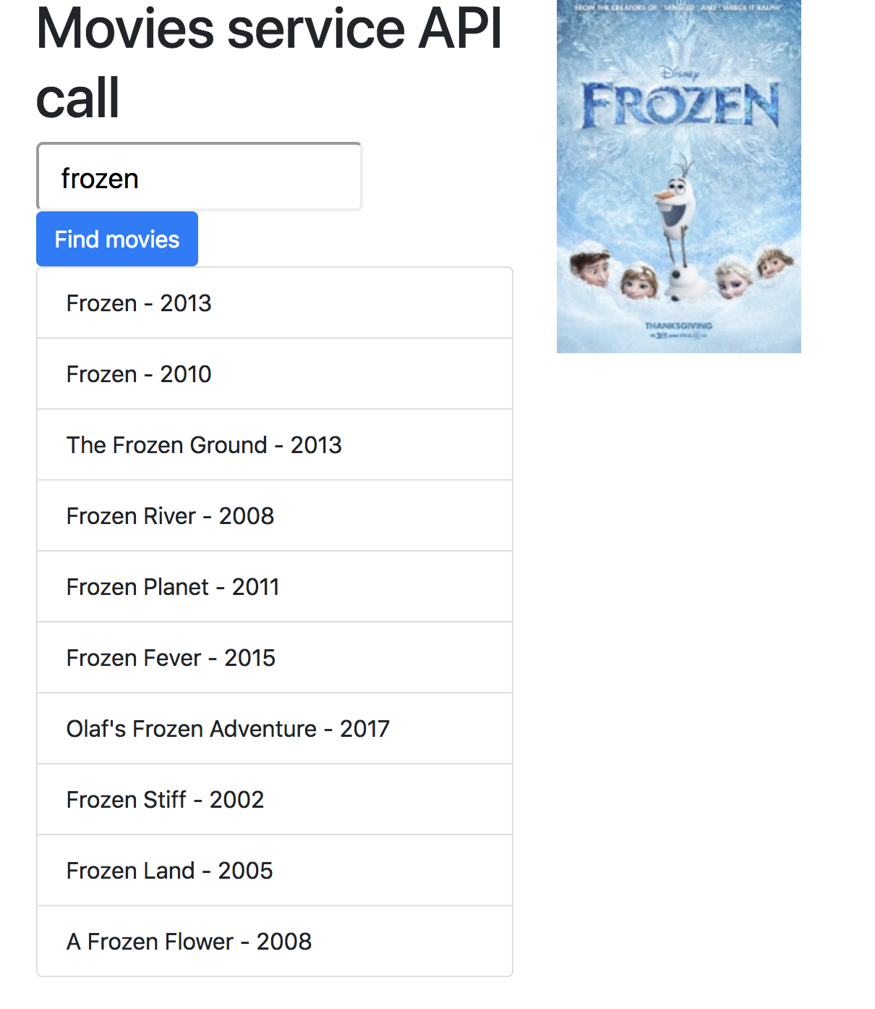
Movies services API call
210-Service Live
211-Service Live with mapping

Slide 48
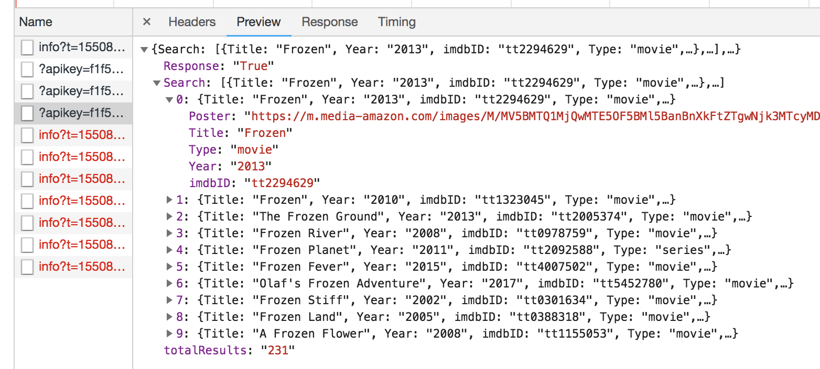

Slide 49
MovieModel
export class MovieModel{
constructor(public titel:string,
public jaar:string,
public afbeelding:string) {
}
}

Slide 50
Weather API

Slide 51
Weather API
Step 1: Get Weather Json
http://api.openweathermap.org/data/2.5/weather?units=metric&appid=8566d604cd9402b65394b034e52aa2af&q=Gouda
Step 2: Generate TypeScript interfaces from JSON
http://json2ts.com/
Step 3 Use the TypeScript interface in the C08-Application

Slide 52
Weather API app
See project: C08-services-live-weather

Slide 53
Voorbeeld API’s
http://openweathermap.org/API (weerbericht)
http://filltext.com/ (random NAW-gegevens)
http://ergast.com/mrd/ - Ergast Motor (F1) API
http://www.omdbapi.com/ - Open Movie Database
http://swapi.co/ - Star Wars API
Zie ook JavaScript APIs.txt met meer voorbeelden

Slide 54
Checkpoint
See 5e
Exercise….
38

